Slide 1
A Look at Group Buying Sites : Group on and Cash-Cash Pinoy

Slide 2
Tuanguo
“Team Buying” “Group Buying” “Store Mobbing”
Started in China
The strategy allows buyers to get discount prices from a retailer when a large group of people were willing to buy the same item
How does it work?
If subscribers to a discount website are tempted by a discount offer, they enter their payment details online and wait. Once a minimum number of people sign up for the same offer, the deal is confirmed and a voucher is sent to their inboxes. Shops, restaurants and other retailers that partner with these discount websites have to take hefty price cuts. But it means they have instant access to a whole new group of customers.

Slide 3

Groupon negotiates huge discounts—usually 50-90% off—with popular businesses. We send the deals to thousands of subscribers in our free daily email, and we send the businesses a ton of new customers. That's the Groupon magic.
The company offers one "Groupon" ("group+coupon") per day in each of the markets it serves. The Groupon works as an assurance contract : if a certain number of people sign up for the offer, then the deal becomes available to all;^{[19]} if the predetermined minimum is not met, no one gets the deal that day.^{[9]} This reduces risk for retailers, who can treat the coupons as quantity discounts^{[9]} as well as sales promotion tools. Groupon makes money by keeping approximately half the money the customer pays for the coupon.^{[9][20]} So, for example, an $80 massage could be purchased by the consumer for $40 and then Groupon and the retailer would split the $40. -- wikipedia.com

Slide 4

“Mercata, is a group-buying site backed by the venture capital firm of Microsoft co-founder Paul Allen. The site lets shoppers band together to get discounts on items by purchasing them in bulk. Specifically, a user would log in find a product he or she was interested in, and tell Mercata how much they were willing to pay for it. The more pepole who signed up, the cheaper the product got.

Slide 5
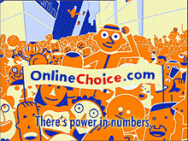

Pittsburgh-based OnlineChoice.com Inc. is an online business that aggregates business and consumer customers to save them money (around 1-5%) on utilities and services. OnlineChoice sells electricity, natural gas, long distance, local telephone service, Internet access, and home security electricity to individuals and small businesses, pooling their purchasing power to negotiate better deals with suppliers.

Slide 6
Question:
Why do you think GroupOn succeeded as against Mercata and OnlineChoice.com – Mercata being the pioneer of Online Group Buying – both of which folded/declared bankruptcy in 2003?

Slide 7
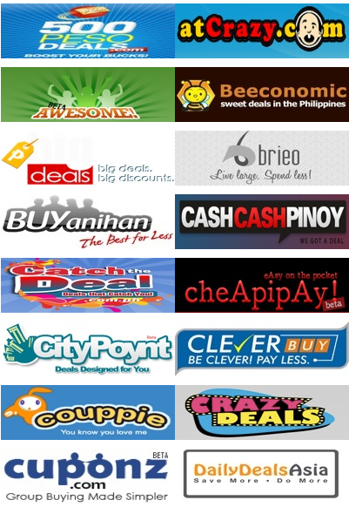

Pushing it further, the Philippines has at least 32 Online Group Buying Sites.
What differentiates one from another?

Slide 8

Officially launched last May 26, 2011
A result of the failed bid of Google to buy out GroupOn.
What makes it different?
Maybe it’s integration with Google Maps and Google Places!
(Shades of “Getting IT Right” – Integrated Platform)

Slide 9
About Business Models
Business models themselves are complex and not well understood – they lack any formal basis that would facilitate both description and comparison.
Linder and Cantrell assert that:
“executives can't even articulate their business models. Everyone talks about business models but 99 percent have no clear framework for describing their model.”
Minimal description
The business model articulates how the business makes money
Linder, J.C., Cantrell, S. (2000): "Changing business models: surveying the landscape", White Paper, Institute for Strategic Change, Accenture

Slide 10
A Business Model….
A business model describes the rationale of how an
organization creates, delivers and captures value!
“There’s not a single business model.. There are really a lot of opportunities and a lot of options and we just have to discover all of them.”

Slide 11
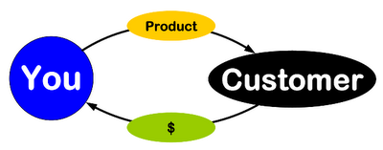
BUSINESS MODEL
How do we deliver value
at an appropriate cost?
What do they value?
Who?
How do we make money?
These are stories that explain how enterprises work

Slide 12
Interesting observations
The most common format for the business model is a single page of narrative text
A business model does not explicitly include implementation technologies
it is driven by business requirements and simply enabled by technology
Articulation of a business model is no guarantee of its success
only implementation will tell if the model works or not
New business models are increasingly viewed as key intellectual property, and often attempts are made to protect them by patent

Slide 13
Extended definition (Perspective 1)
Chesborough and Rosenbloom specify that the 6 functions of a business model are to:
Articulate the value proposition
Identify a market segment, i.e. the users to whom the offering is useful and for what purpose, and specify the revenue generation mechanism for the firm.
Define the structure of the value chain within the firm to create and distribute the offering and determine the complementary assets needed to support the firm’s assets in this chain.
Examine the cost structure and profit potential of producing the offering given the value proposition and value chain structure chosen.
Describe the position of the firm within the value network linking suppliers and customers including identification of potential complementors and competitors.
Formulate the competitive strategy by which the innovating firm will gain and hold advantage over rivals.
Chesborough, Henry; Rosenbloom, Richard: The role of the business model in capturing value from innovation: evidence from Xerox Corporation’s technology spin-off companies, Industrial and Corporate Change, Volume 11, Number 3 pp529-555.

Slide 14
Extended definition (Perspective 2)
Magretta identifies 2 key areas in a business model description
The story
The numbers
Both have to make sense
When business models don't work, it's because they fail either the narrative test (the story doesn't make sense) or the numbers test (the P&L [profit and loss] doesn't add up).
Magretta, J: Why Business Models Matter, Harvard Business Review 2002, Vol 80; Part 5, ISSN 0017-8012, pages 86-93.
Notes:
I

Slide 15
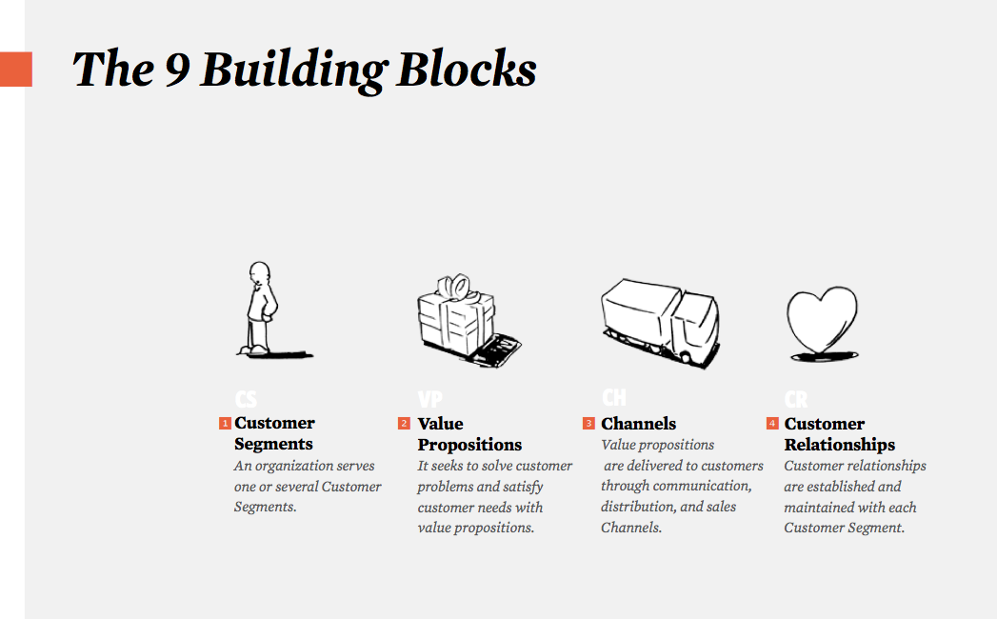
Business Model Canvas (Perspective 3)

Slide 16
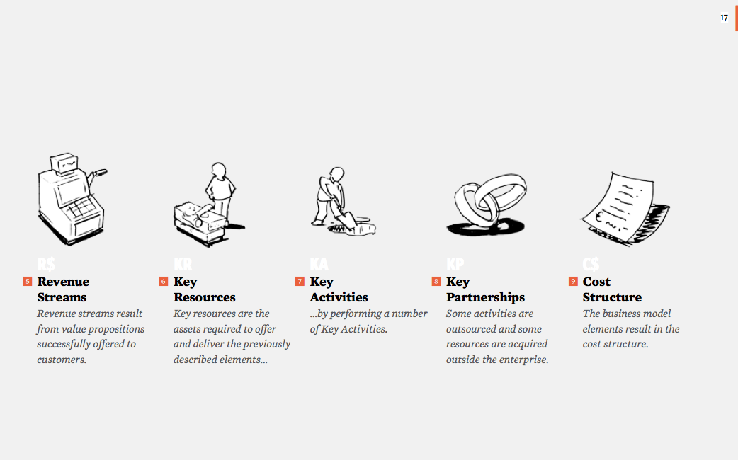
The Business Model Canvas (con’t)

Slide 18
Approaches to Business Model Evolution
Enhance
Extend
Add functionality or features to current
Enter new line of business and/or add new
product/service offerings or improve
business models
performance of existing business
Extend
Enhance
Expand
Exit
Exit
Expand
Exit a business or market or drop a
Add new product/service offerings
product/service offering
or enter new geographic markets

Slide 19
Sources of Images
Slide 2: http://oursoulunited.files.wordpress.com/2010/12/scarcity_abundance.jpg
Slide 2: http://nospillsales.info/wp-content/uploads/2010/12/selling-competition.jpg
Slide 2: http://www.infobarrel.com/media/image/62664.jpg
Slide 4: http://www.doonlinejob.com/wp-content/uploads/2011/08/bag_of_money.png
Slide 4: http://3.bp.blogspot.com/-AVKnBdQi14k/Tiw__mtpgDI/AAAAAAAAAN4/fS_Kvh5VMbo/s1600/price-tag-images.jpg
Slide 4: http://www.featurepics.com/FI/Thumb300/20110226/Price-Tag-Label-1798760.jpg
Slide 4: http://us.123rf.com/400wm/400/400/ppart/ppart0903/ppart090300144/4528568-sale-price-tag-from-red-set-computer-generated-3d-photo-rendering.jpg
Slide 4: http://image.shutterstock.com/display_pic_with_logo/131278/131278,1208503412,4/stock-photo-reduced-price-tag-illustration-11650330.jpg
Slide 4: http://www.responsible-investor.com/images/uploads/articles/green_funds_growth.jpg
Slide 4: http://goodliferetirement.com/wp-content/uploads/2011/07/investment.jpg
Slide 4: http://www.clker.com/cliparts/7/e/6/e/12362679192063758008AX11_factory.svg.med.png
Slide 4: http://dir.coolclips.com/Industry/Distribution/Conveyor_Belts/conveyor_belt_CoolClips_vc038859.jpg
Slide 4: http://l.thumbs.canstockphoto.com/canstock6852908.jpg
Slide 5 : http://3.bp.blogspot.com/-RHSZur174go/TdfhoytSHTI/AAAAAAAAAEA/2X_-QRDgrXE/s1600/IPKat%2B08%2Bamazon_one_click.png
Slide 5 : http://tariqweb.com/wp-content/uploads/2011/07/15.jpg
Slide 5 : http://upload.wikimedia.org/wikipedia/en/thumb/b/bf/KFC_logo.svg/160px-KFC_logo.svg.png
Slide 5 : http://www.ravensturf.com/img/buy-viagra-sildenafil-100mg-online.jpg
Slide 8 : http://www.dur.ac.uk/images/greenspace/smallicons/travel_icon.png
Slide 8 : http://www.lhiprint.com/images/Copies.jpg?653
Slide 8: http://us.cdn4.123rf.com/168nwm/seamartini/seamartini1001/seamartini100100063/6250878-color-graph-for-design-and-business-concept.jpg
Slide 8 : http://stevesbankingsite.com/wp-content/uploads/2010/01/Customer-Service-Provider-300x225.jpg
Slide 8 & 9 : http://adawnjournal.com/wp-content/uploads/2010/04/WhatIsDeflation.jpg
Slide 9 : http://www.1stwebdesigner.com/wp-content/uploads/2009/07/free-twitter-icons/follow-me-twitter-icon-free.jpg
Slide 11 : http://www.munknee.com/wp-content/uploads/2009/10/Purchasing-Power.jpg
Gears : http://www.o2env.com/wp-content/uploads/2010/08/assesment.png

